Slide 1

GIDC RAJJU SROFF ROFEL INSTITUTE OF MANAGEMENT OF STUDIES (BBA) & ROFEL SHRI G.M BILAKHIA COLLEGE OF APPLIED SCIENCES (BCA), VAPI
Project Presentation On
Chatting application
Guided By:
Prof. Tanvi Rana
Submitted By:
Shubham Kumar Yadav
350

Slide 2
Contents
Introduction
objective
Project profile
Model
System flow chart
Dfd diagram
Er diagram
Screenshot
Future scope
references

Slide 3
INTRODUCTION
The primary use of a chat room is to share information via text with a group of other users. Generally speaking, the ability to converse with multiple people in the same conversation differentiates chat rooms from instant messaging programs, which are more typically designed for one-to-one communication. The users in a particular chat room are generally connected via a shared internet or other similar connection, and chat rooms exist catering for a wide range of subjects.

Slide 4
OBJECTIVE
The main objective of the Online Chat Application is to manage the details of Chat Application, Online Chat, Smiles Chat, Users, Chat History. It manages all the information about Chat Application, Chat Profile, Chat History, Chat Application. The purpose of the project is to build an application program to reduce the manual work for managing the Chat Application, Online Chat, Chat Profile, Smiles Chat. It tracks all the details about the Smiles Chat, Users, Chat History.

Slide 5
PROJECT PROFILE
Group Members:- | Shubham Kumar Yadav.
Project Title:- | “Online Chatting Application.”
College Guide Name:- | Prof. Tanvi Rana.
Hardware Configuration:- | HARD DISK:- 1TB RAM:8GB.
Software Configuration:- | Microsoft Edge.
Operating System:- | Windows 11.
Platform:- | Android Studio(Electric Eel | 2022.1.1) , Figma, Firebase and PHP.
Project Technology:- | Android Studio, Kotlin, Firebase, Figma and PHP.
Front End:- | Android Studio and Figma.
Back End:- | Kotlin and PHP.
Database:- | Firebase.

Slide 6
FRONT-END
Android Studio
Figma
HTML (Hypertext Markup Language).
CSS (Cascading Style Sheets).
BOOTSTRAP.
JavaScript.

Slide 7
BACK-END
Kotlin.
Firebase.
PHP (Hypertext Preprocessor).

Slide 8
MoDELs
Incremental Model :-
Incremental Model is a process of software development where requirements divided into multiple standalone modules of the software development cycle. In this model, each module goes through the requirements, design, implementation and testing phases. Every subsequent release of the module adds function to the previous release. The process continues until the complete system achieved.

Slide 9
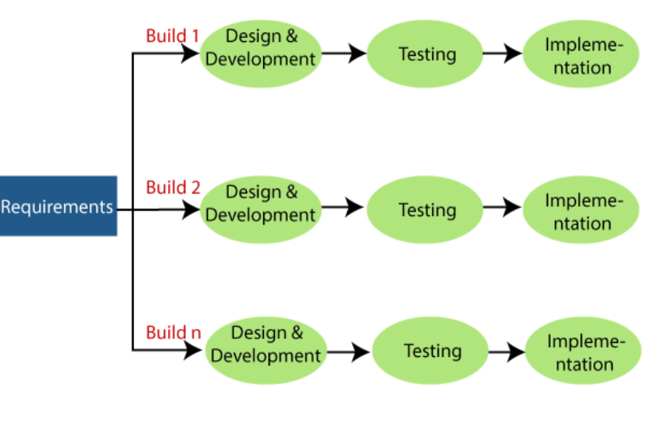
Incremental Model

Slide 10
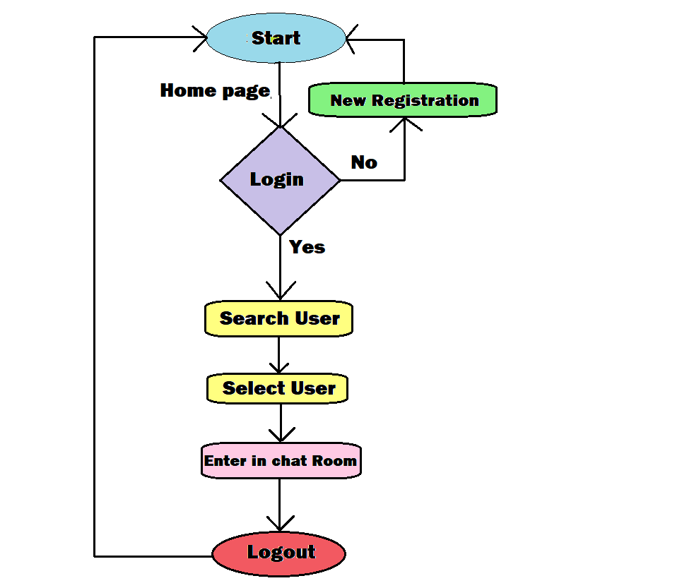
SYSTEM FLOW CHART

Slide 11
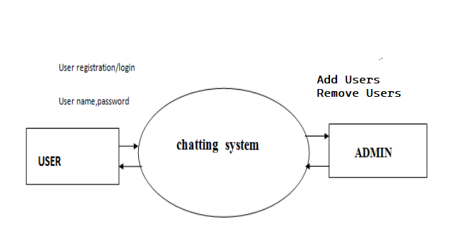
DFD DIaGRAM
Zero Level:-
Zero Level DFD.

Slide 12
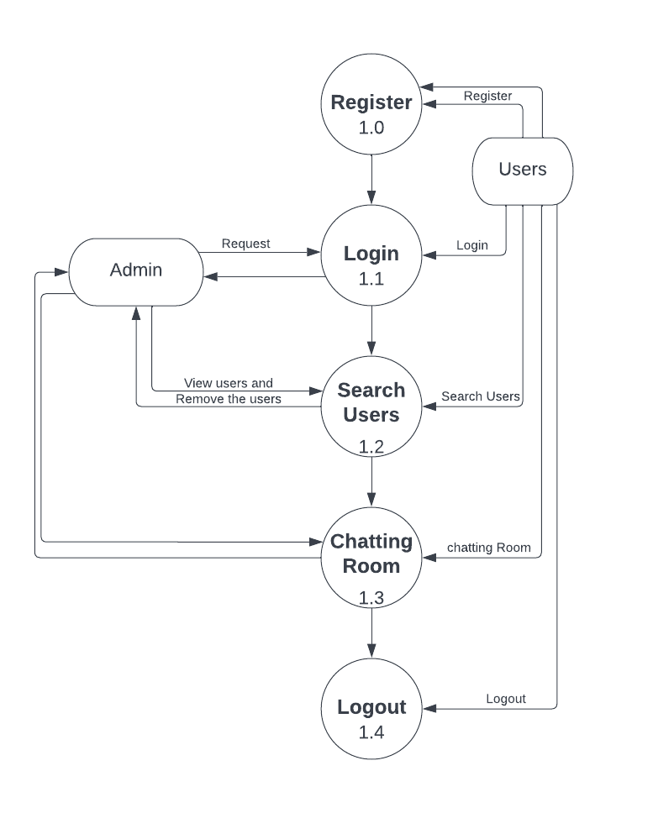
First Level:-
First Level DFD.

Slide 13
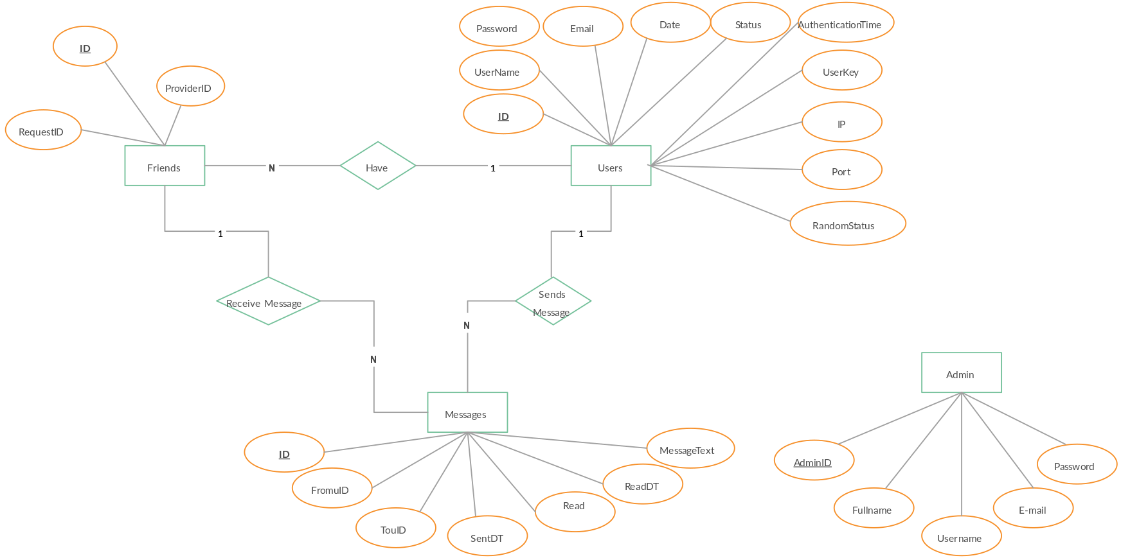
ER DIAGRAM(ENTITY RELATIONSHIP DIAGRAM):-

Slide 14
SCREENSHOTS

Slide 15

Welcome PAGE:-

Slide 16
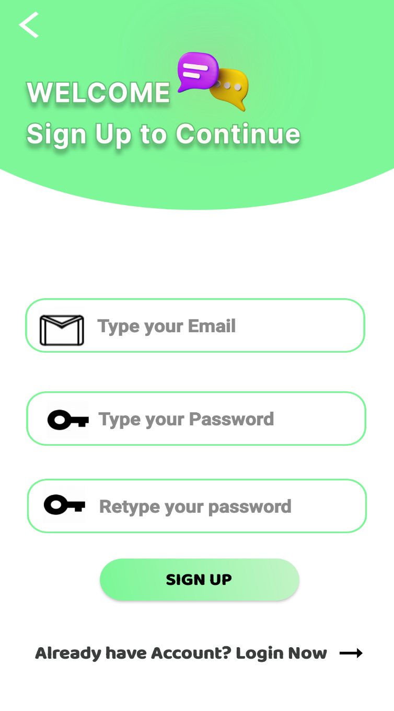
Signup Page:-

Slide 17
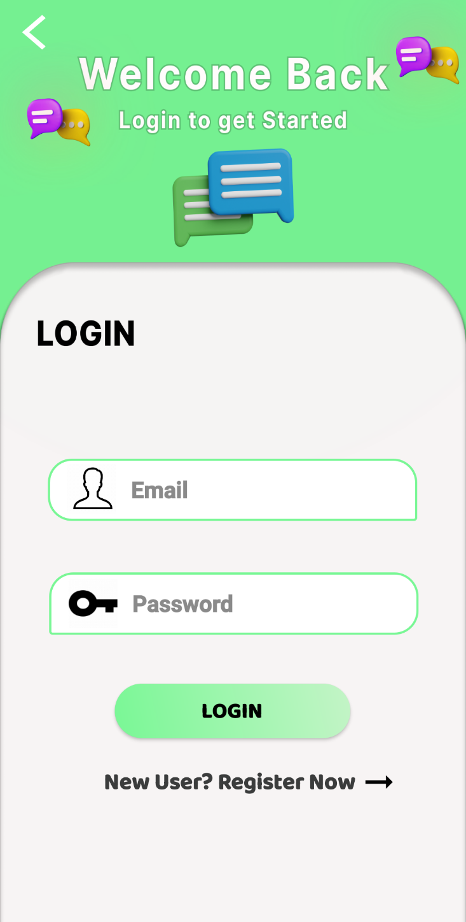
Login Page:-

Slide 18
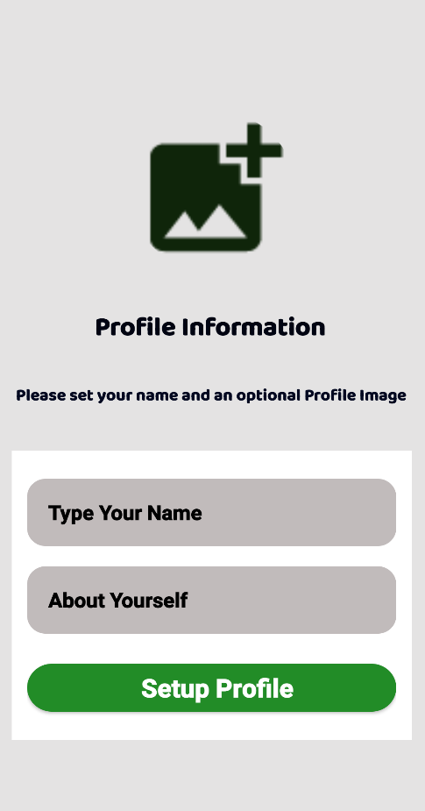
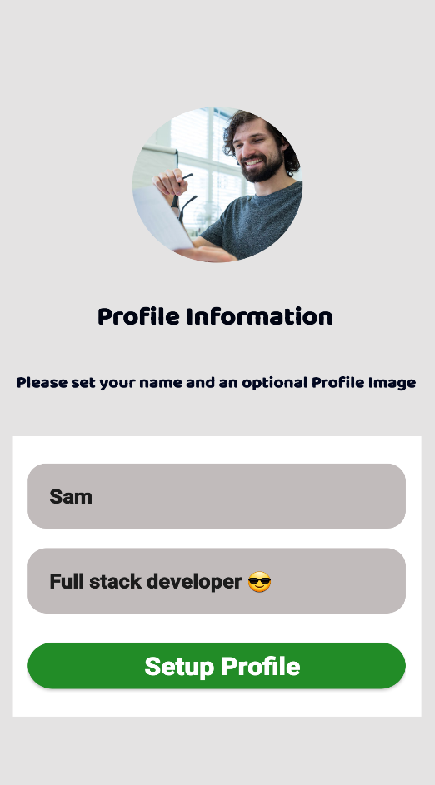
Profile Setup Page:-

Slide 19
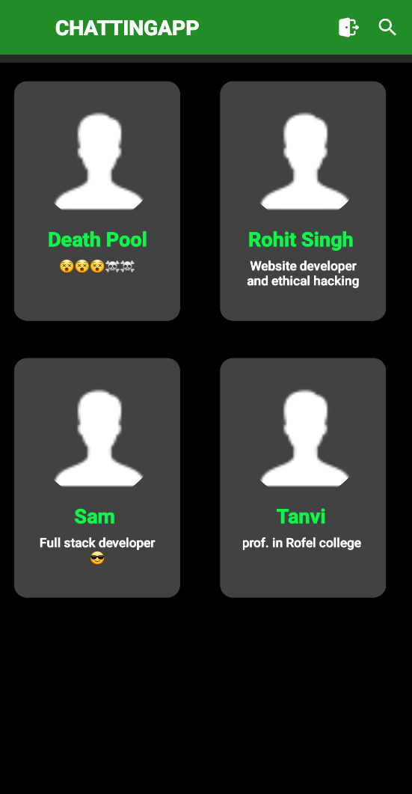
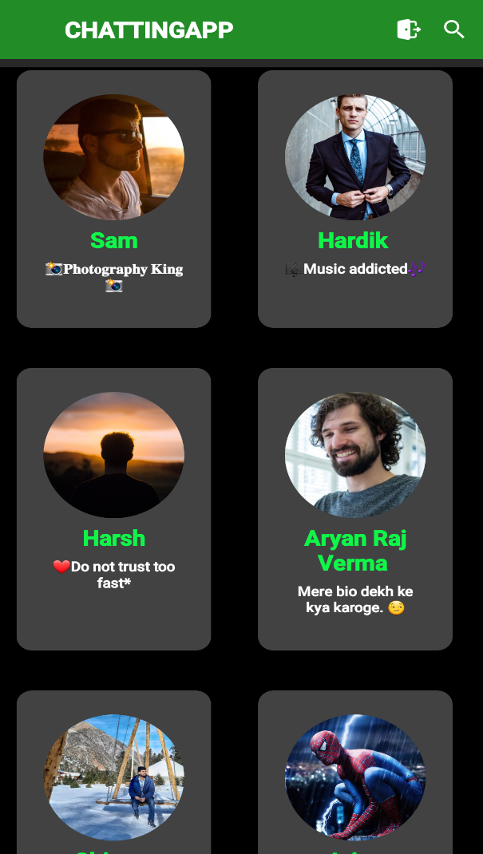
User Page:-
Without Internet
With Internet

Slide 20
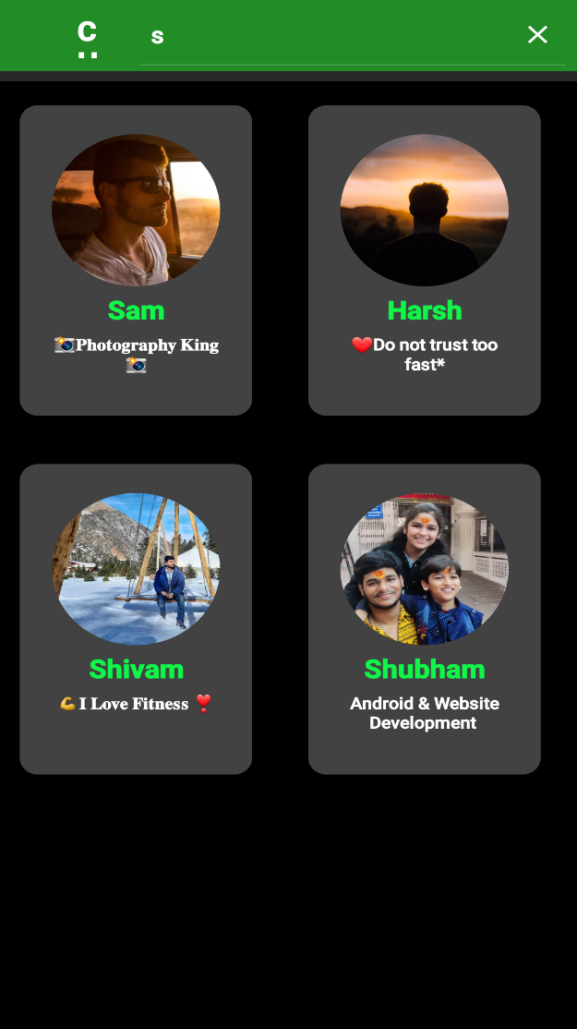
Search Users:

Slide 21
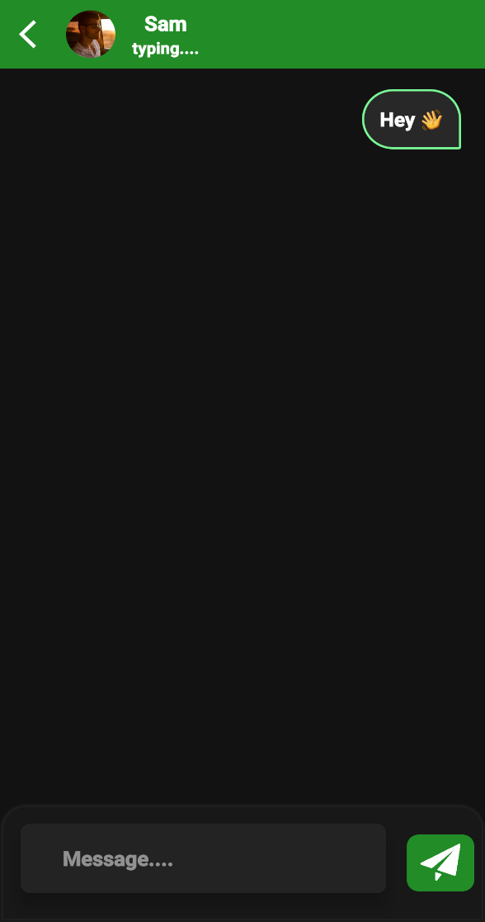
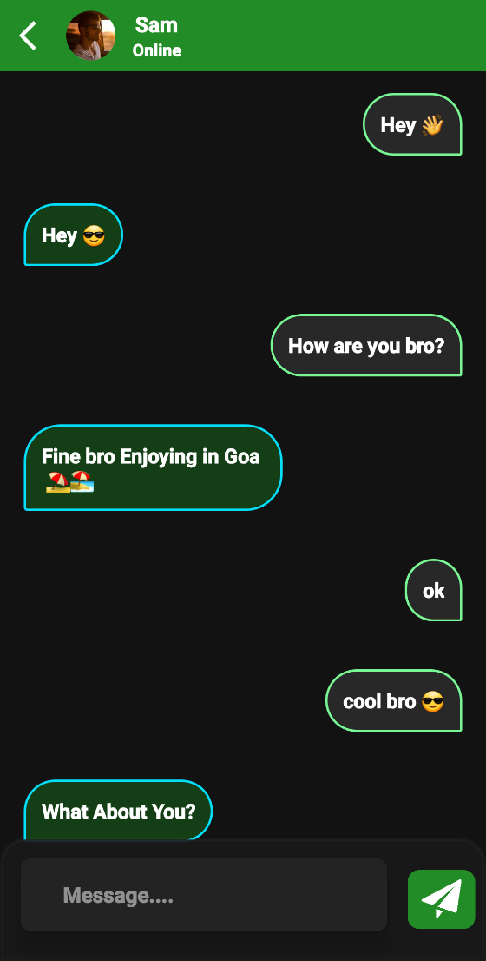
Chat Room Page:-

Slide 22
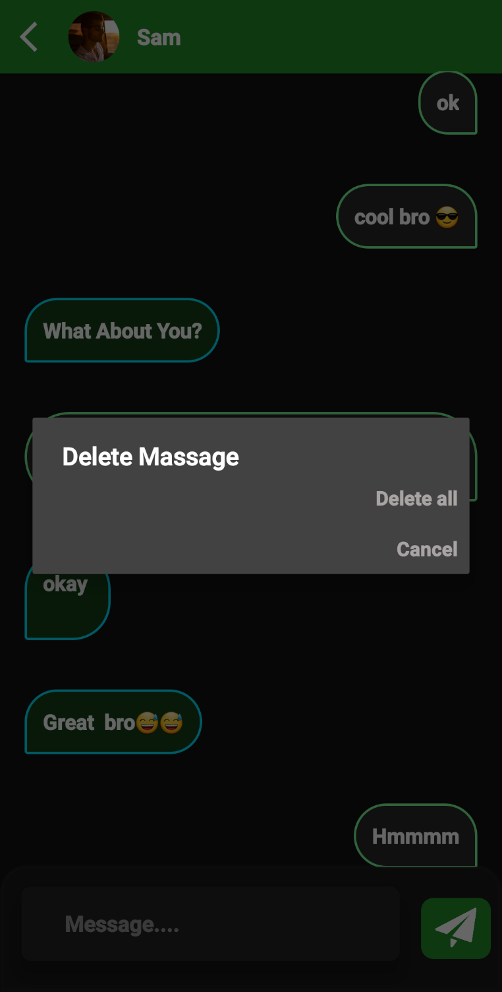
Message Delete:

Slide 23
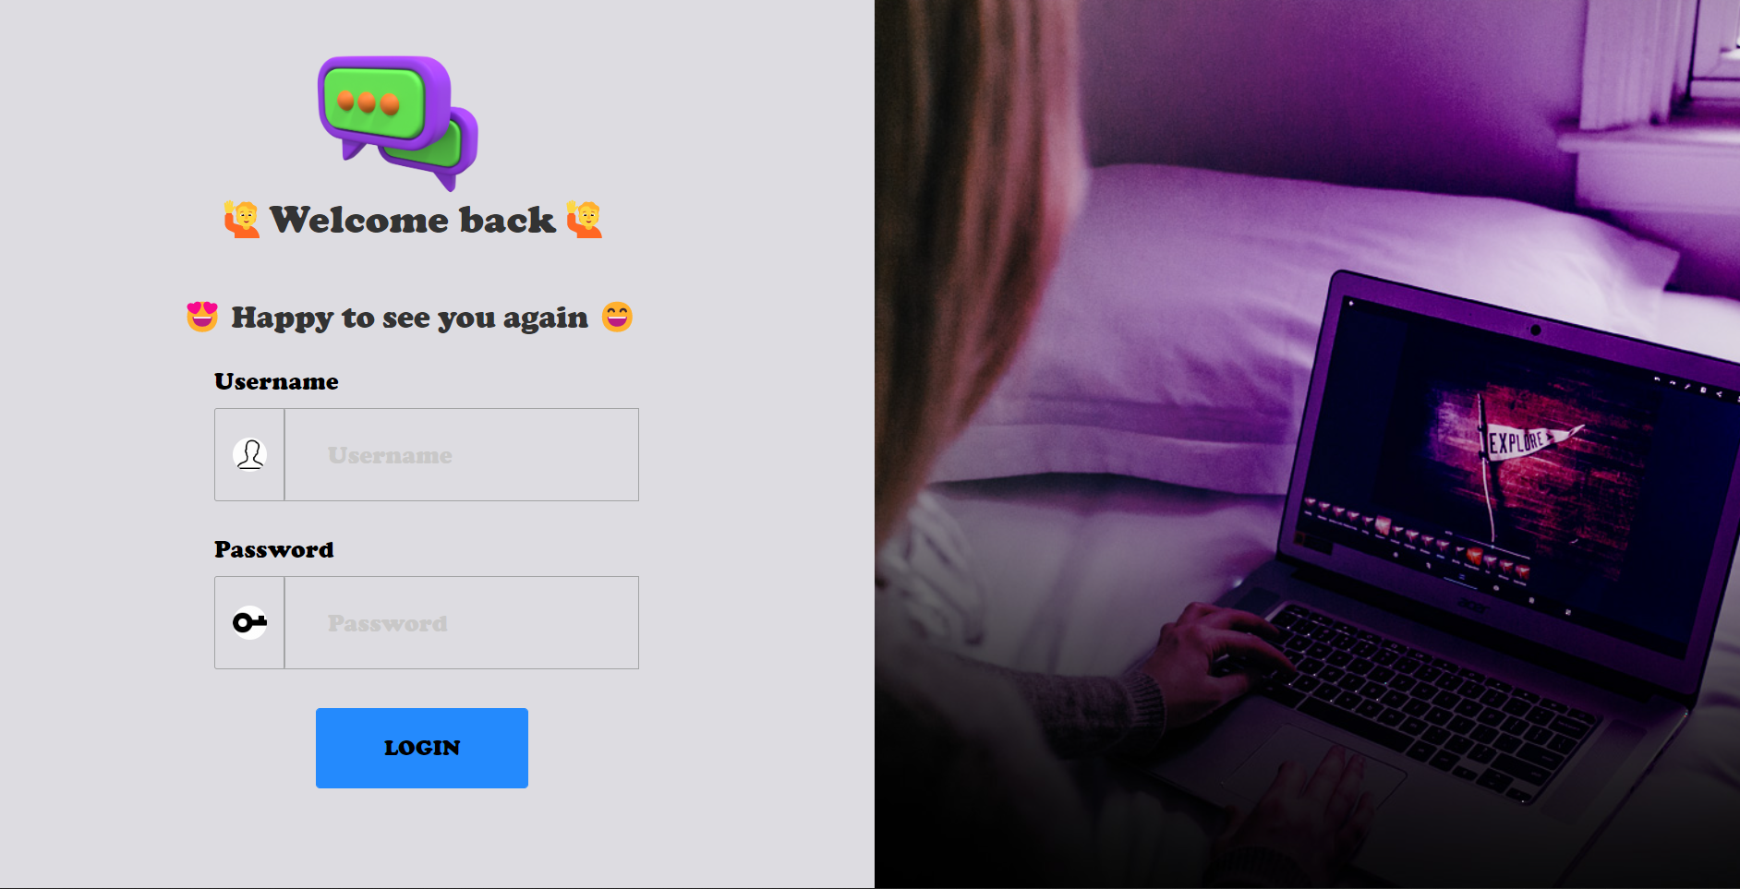
Admin Login Page:-

Slide 24
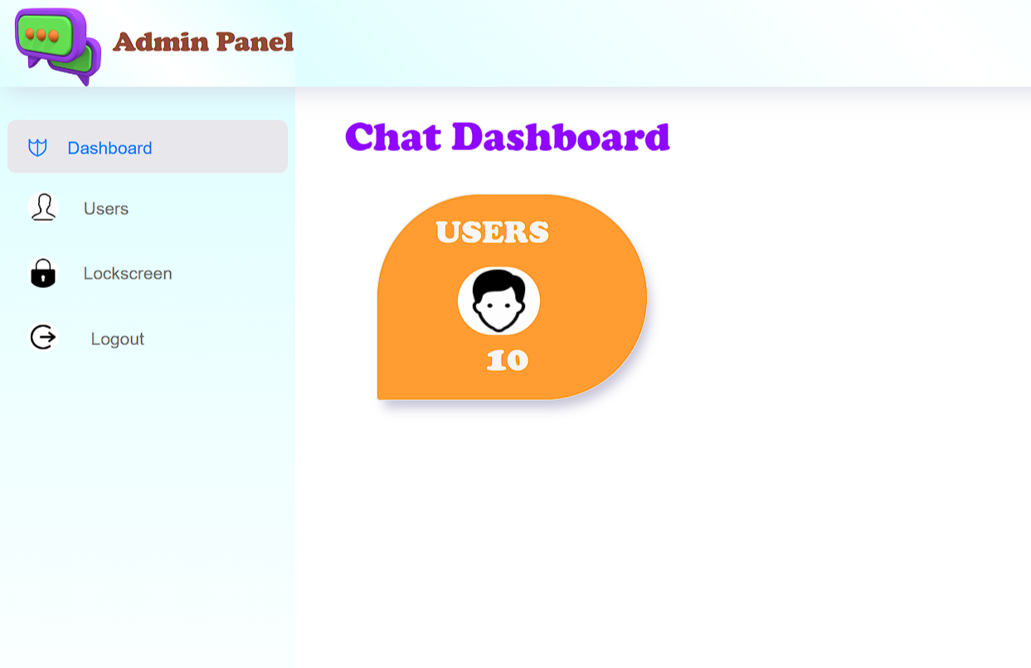
Admin Panel Page:-

Slide 25
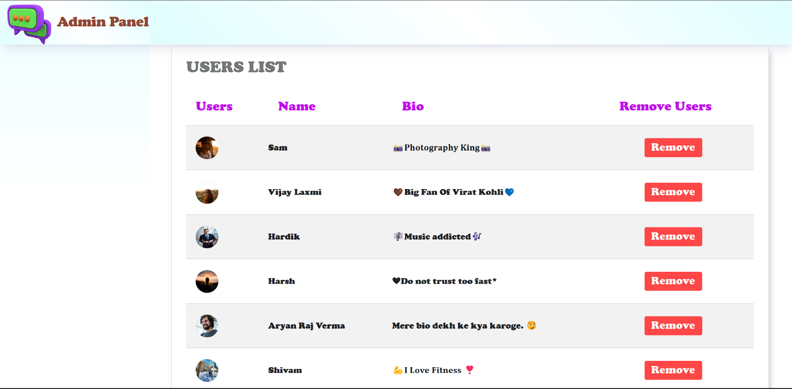
Users List Page:

Slide 26
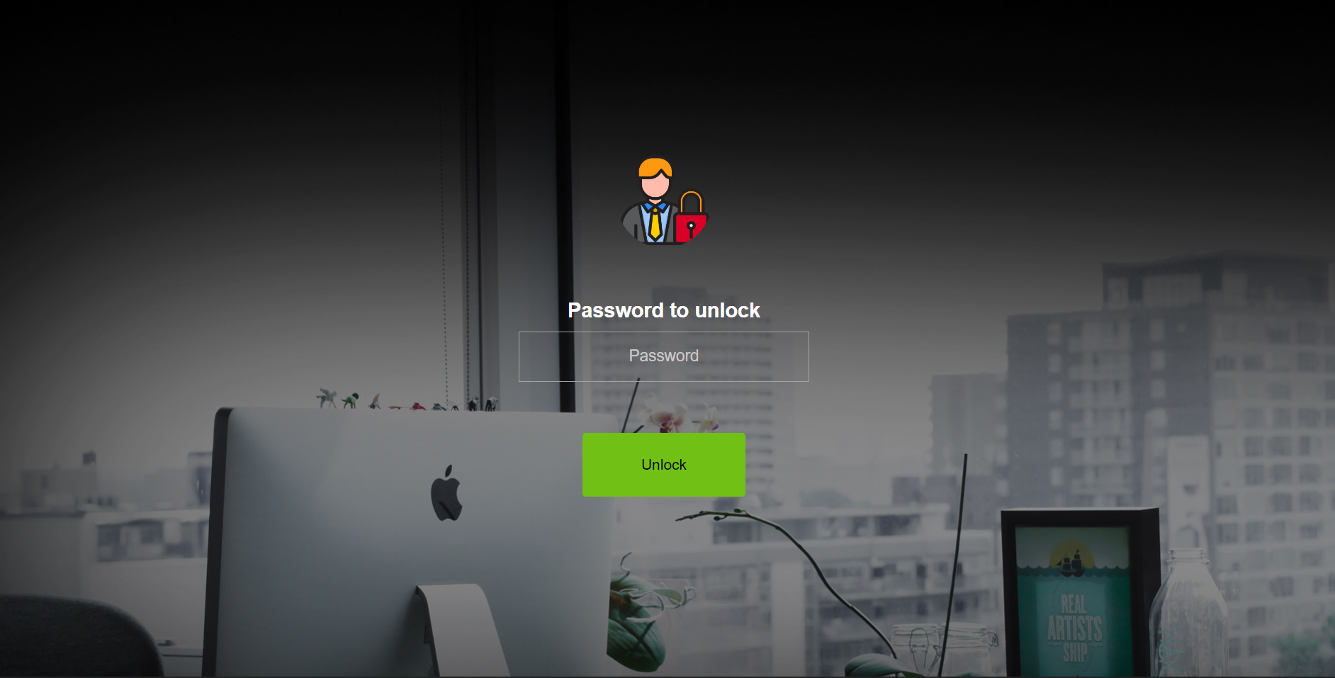
Lock Screen Page:-

Slide 27
FUTURE SCOPE
Future Scope:-
With the knowledge I have gained by
Developing this Web application, I am confident that in the future
I can make the Web application more effectively by adding this Services.
Video call.
Voice call.
Photos Sending.
Video Sending.
Voice Recording Chat.

Slide 28
References
www.realtimechatroom.com
http://chatroom.org
https://www.WhatApps.com
https://firebase.google.com/docs
https://developer.android.com/kotlin
https://www.figma.com
https://www.google.com

Slide 29
THANK You

